Slide 1
Contact details
Chief Executive and Directors
Jim Savege, Chief Executive
jim.savege@aberdeenshire.gov.uk
PA: Lorna Nicoll
01467 535986
Ritchie Johnson, Director of Business Services
ritchie.johnson@aberdeenshire.gov.uk
PA: Wendy Thain
01467 532987
Alan Wood, Director of Environment and Infrastructure Services
Alan.wood@aberdeenshire.gov.uk
PA: Louise Smith
01467 537754
Laurence Findlay, Director of Education and Children’s Services
Laurence.Findlay@aberdeenshire.gov.uk
PA: Caran Richardson
01467 538579
Pamela Milliken, Chief Officer Aberdeenshire Health and Social Care Partnership
Pamela.Milliken@aberdeenshire.gov.uk
PA: Lisa Pratt
01467 469168
Contact centre numbers:
Benefits 03456 08 12 00
Council Tax, Business Rates & Payments Due 03456 08 12 01
Education & Leisure Facilities 03456 08 12 02
Housing, inc. emergency out of hours service 03456 08 12 03
Planning & Building Standards 03456 08 12 04
Roads, Parks & Open Spaces 03456 08 12 05
Social Care, inc emergency out of hours 03456 08 12 06
Waste & Environmental Health 03456 08 12 07
General Enquiries for all other services 03456 08 12 08
IT Service desk
Visit the IT Hub or 01467 538000
AskHR
askHR@Aberdeenshire.gov.uk or 01467 534400
If you have any accessibility issues please contact news@aberdeenshire.gov.uk

Slide 2
Area Manager contact details
Banff & Buchan
Angela Keith
01467 536785
Angela.keith@aberdeenshire.gov.uk
Buchan
Amanda Roe
01467 536139
Amanda.roe@aberdeenshire.gov.uk
Formartine
Elaine Brown
01467 539508
Elaine.brown@aberdeenshire.gov.uk
Garioch
Ann Overton
01467 539413
Ann.overton@aberdeenshire.gov.uk
Kincardine and Mearns
Bruce Stewart
01467 535796
Bruce.stewart@aberdeenshire.gov.uk
Marr
Janelle Clark
01467 536420
janelle.clark@aberdeenshire.gov.uk
Please note, each Area Manager is based in their respective area, however all have Inverurie number.

Slide 3
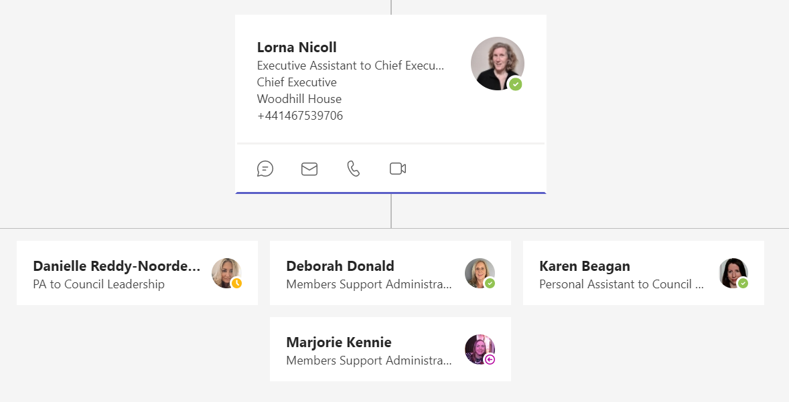
Members’ support

